Slide 1
Making this resource work for you
Prior to teaching this lesson, please refer to the ‘Unit Overview and Planning Document’.
Further guidance on planning Science Mastery lessons can be found in the detailed planning guidance document.
Refer to the ‘notes’ section on each slide for useful information, including suggested expositions, pedagogical content knowledge, suggested questions, answers and more. Consider using presenter mode so you can see this guidance throughout the lesson.
The introduction slides can be adapted to suit your teaching style and the needs of your class.
Before the lesson, adapt the fix-it slide to address any misconceptions identified in the previous lesson’s exit ticket.
Choose from the suggested activities to suit your class. The intention is not that you complete all of these, but that you select those which ones are most appropriate for your students. It may be appropriate to further adapt activities for your students.
These lessons are designed to occupy approximately 1 hour. To adapt for a shorter or longer lesson duration we advise you to adapt the activity section accordingly.
Please consider using the final slide to send feedback about this lesson or examples of PowerPoints that you have adapted to our design team. Your feedback is used to improve Science Mastery for all of our teachers and students. We appreciate all suggestions and comments.
Thank you for reading!
The Science Mastery Team

Slide 2
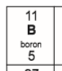
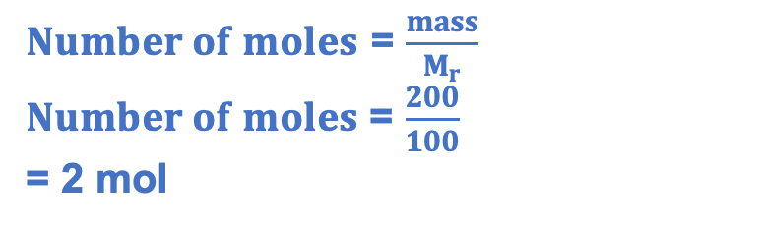
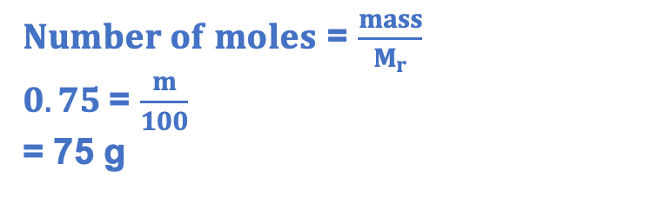
Prior Knowledge Review: Concentration
Answer the questions below.
State how many particles there are in 1 mole of a substance.
Calculate the M_{r} of calcium carbonate (CaCO₃). Ca=40, C=12, O=16
Calculate the number of moles in 200 g of calcium carbonate.
Calculate the mass of 0.75 moles of calcium carbonate.
6.02 x 10²³
100
$Number of moles$ = $\frac{mass}{M_{r}}$
$Number of moles$ = $\frac{200}{100}$
= 2 mol
$Number of moles$ = $\frac{mass}{M_{r}}$
$0.75$= $\frac{m}{100}$
= 75 g
Notes:
Big idea: Reactions rearrange matter
Foundation: Calculate the relative formula mass of water (H₂O).
Stretch: Calculate the percentage by mass of oxygen in calcium carbonate.
Answers:
Foundation: (2x1)+16 = 18
Stretch: (16x3)/100 x100 = 48 %

Slide 3
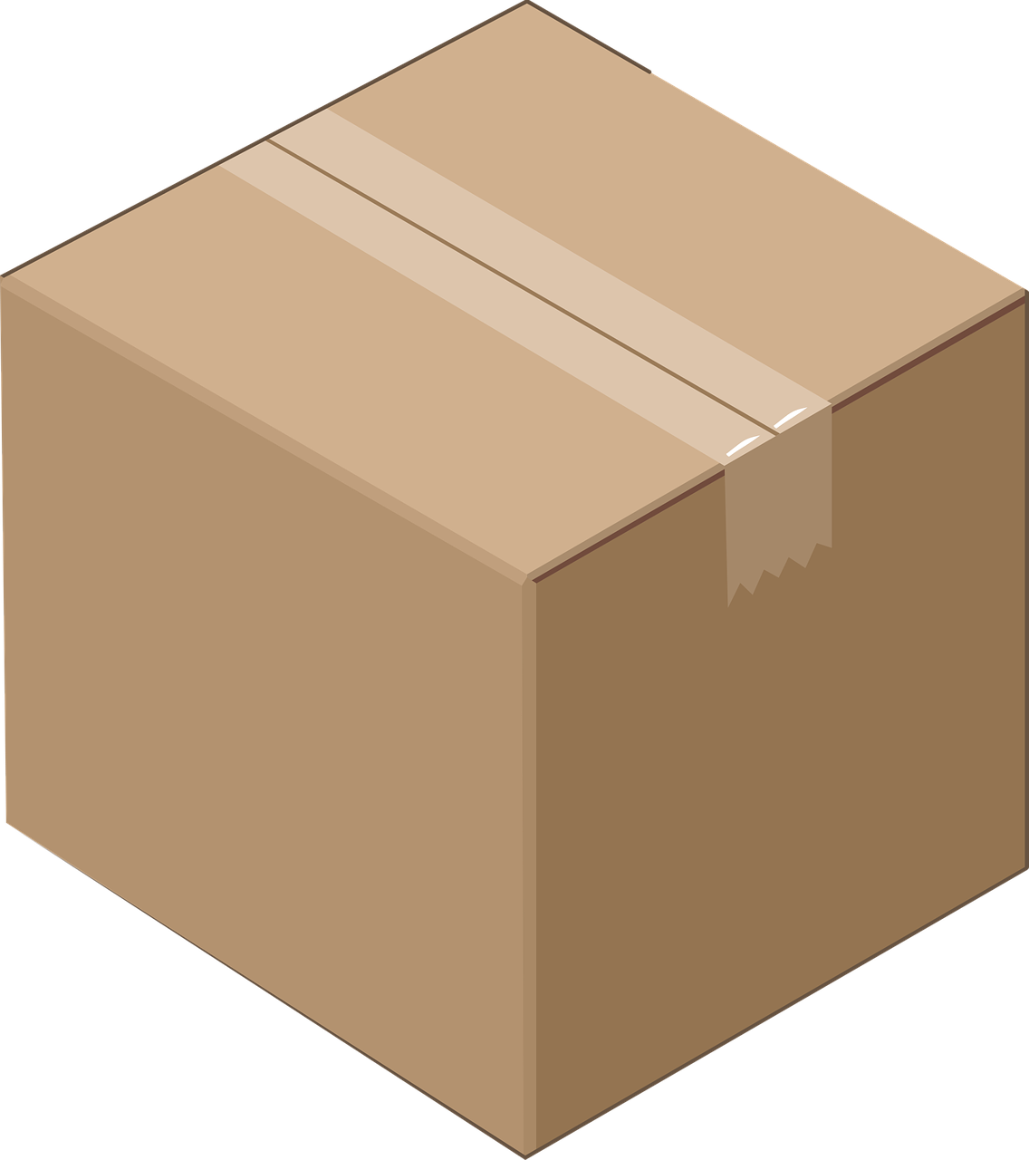
Prior Knowledge Review: Concentration
Do Now:
State how many particles there are in 1 mole of a substance.
Calculate the M_{r} of calcium carbonate (CaCO₃). Ca=40, C=12, O=16
Calculate the number of moles in 200 g of calcium carbonate.
Calculate the mass of 0.75 moles of calcium carbonate.
Drill:
25 cm
State the unit of mass (in chemistry).
Calculate the volume of this box.
Convert this to dm³.
15 cm
20 cm
Notes:
Drill answers:
g
7875 cm³
7.9 dm³

Slide 4
Prior Knowledge Review: Concentration
Read Now:
Concentration is the mass of a solute per unit volume of a solution. When sugar is dissolved in water, sugar is the solute, water is the solvent and the sugary water is the solution. The mass of sugar in the given volume of solution is its concentration, so the greater the mass of sugar that is dissolved in the solution, the more concentrated it is. We can calculate concentration in terms of mass per unit volume using the equation: concentration = mass/volume.
Define concentration.
Explain the difference between a solute and a solvent.
Describe the relationship between the mass of a solute that is dissolved in a solution and its concentration.
State the equation that links concentration, mass and volume.

Slide 5
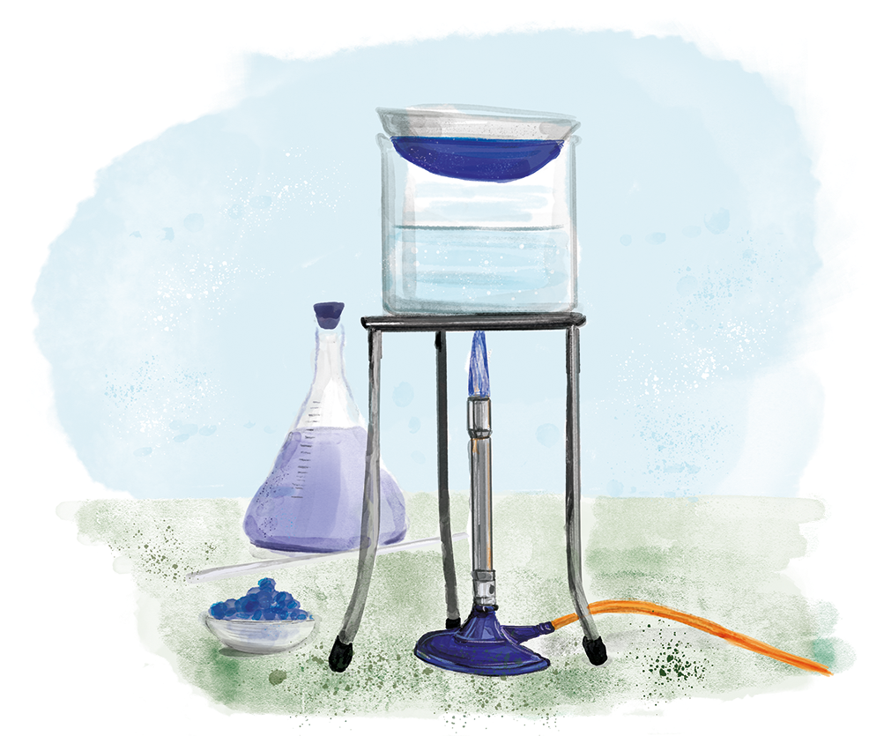
C4.3.4
03/02/2025
Prior Knowledge Review: Concentration
C4.3.1 Prior Knowledge Review
C4.3.2 (HT) Introducing the Mole
C4.3.3 (HT) Mole Calculations
C4.3.4 PKR: Concentration
C4.3.5 TIF: Calculating Concentration
C4.3.6 TIF: Calculating an Unknown Concentration
C4.3.7 (HT) Amounts of Substances in Equations
C4.3.8 (HT) Limiting Reactants
C4.3.9 PKR: Reactions of Acids
C4.3.10 Acids, Alkalis and Neutralisation
C4.3.11 TIF: Acid-Alkali Titration
C4.3.12 TIF: Acid-Alkali Titration Analysis
C4.3.13 TIF: Titration Calculations
C4.3.14 (HT) Strong and Weak Acids
C4.3.15 TIF: Volumes of Gases
Notes:
Big idea: Reactions rearrange matter
In the previous lesson, students will review the concept of concentration and the calculation of concentration using g/dm3 from C3.2. In the next lesson, which is chemistry only, students will then build on this when calculating concentration in mol/dm3.
Suggested Hook:
What does it mean if a bottle of squash is more concentrated than a carton?

Slide 6

Following this lesson, students will be able to:
Define concentration
Convert between cm³ and dm³
Calculate concentration from a given mass and volume
Key Words:
mass
volume
concentration
solute
solution
Notes:
Guidance:
See unit overview document and planning guidance to see how these objectives are typically assessed at GCSE, including examples of what students should be able to do following this lesson.
Planning for different needs:
The learning objectives given on this slide are suggested based on the most common requirements for exams, however they can be adapted based on the needs of different classes.
For best practice, the unit preparation booklet should be used to determine the appropriate focus of lessons within the unit.
While it is not possible to explicitly split content into levelled grades, we recommend that lesson objectives can be classified as critical, core or stretch.
Critical: the content or skill is essential for all students to be able to progress.
Core: the content or skill is important for students to progress, but other opportunities may be available to revisit it.
Stretch: the content or skill may not be essential for all students but is important for students aiming for the highest grades.
Key skill: this is a crucial skill being developed in this unit as part of the skill mapping
C4.3.4 Lesson Objectives:
Critical: Define concentration
Key skill: Convert between cm³ and dm³
Core: Calculate concentration from a given mass and volume

Slide 7
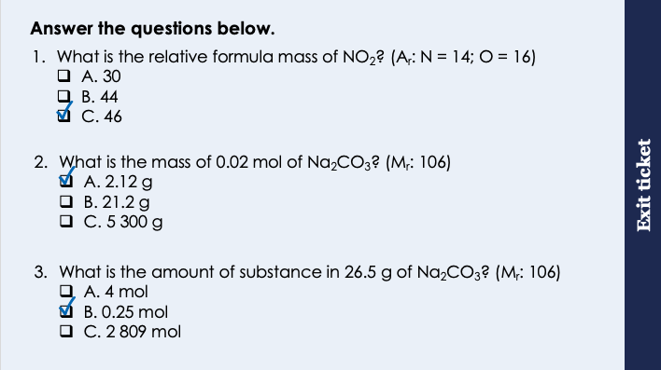
This is the fix-it portion of the lesson
The fix-it is an opportunity to respond to gaps in knowledge, especially those identified by the pre-unit quiz.
The teacher should customise this slide as needed, to facilitate
reteach, explanation, demonstration or modelling of ideas and concepts that students have not yet grasped or have misunderstood.
practise answering specific questions or of key skills.
redrafting or improving previous work.
Notes:
Purpose: to spend time on any gaps identified in previous learning from exit ticket.
Fix-it guidance from previous exit ticket:
Q1. Answer: C
If students answer A, they have not included the two oxygen atoms. If students answer B, they have used the two for nitrogen rather than oxygen. To fix-it, give students lots more practice of Mr calculations.
Q2. Answer: A
If students answer B, they have likely entered the 0.02 incorrectly on the calculator, Missing zeroes is a common cause of lost marks in exams. If students answer C, they have made the common mistake of always assuming that a calculation will be large number/small number. To fix-it, give students further practice of identifying the number of atoms in 1 mole of different elements and compounds.
Q3. Answer: B
If students answer A, they have divided Mr by mass, again likely assuming that big number should be divided by small number. If students answer C, they have multiplied the given values. To fix-it, review the equation and give students plenty of practice solving for Mr and mass.

Slide 8
Which is more concentrated?
Purple juice is added to two glasses of water.
The concentration of a solution tells you how much solute is dissolved in a given volume of a solution.
Notes:
These slides are a review from C3.2.
Exposition type: Explanation
This activity introduces concentration in a qualitative way, before bringing in the quantitative.
It is worth demonstrating the dilution of squash to show a dilution series, or to ask questions about what is happening to the mass of solute per unit volume as the dilution occurs. Be very clear regarding the meaning of the term ‘amount’ as students have now met amount of substance meaning moles. At this stage focus on mass in g.
Suggested exposition:
A solution is composed of a solute and a solvent.
• A solvent is the substance a solute dissolves in
• A solute is the substance that dissolves in a solvent.
• A saturated solution is a solution in which no more solute will dissolve
• An unsaturated solution is a solution in which solute will dissolve
• A substance is soluble if it will dissolve to form a solution
• A substance is insoluble if it will not dissolve to form a solution
• A solute dissolves when the solute particles fill in the spaces between the solvent particles
The concentration of a solution tells you how much solute is dissolved in a given volume of a solution.
The PhET animation can be used at any point in the introduction, suggested with slide 10. The link is: https://edu.rsc.org/download?ac=501331 or https://phet.colorado.edu/en/simulation/concentration
Image source
https://world.openfoodfacts.org/product/9300673000484/blackcurrant-juice-syrup-ribena (creative commons)
https://world.openfoodfacts.org/product/5054267006102/ribena-blackcurrant (creative commons)

Slide 9
Volume
Volume is the amount of space that a substance or object takes up.
How many units of volume can you think of?
m³ (cubic metres)
cm³ (cubic centimetres)
L (Litres)
mL (millilitres)
Scientists use a different unit of volume: dm³ (cubic decimetres)
1 dm³ = 1 L = 1000 cm³
Notes:
Suggested exposition:
What do we mean by volume? Volume is the amount of space that something takes up.
Look at two chairs – they take up the same amount of space, so we can say that they have the same volume.
Look at a beaker of water, we can read from the side the the volume of the liquid here is 250 cm³. Now if I pour this liquid into another container, say this graduated cylinder, has the volume changed? No. The shape that this liquid takes up has changed, but the volume has not changed. If I poured this liquid all over the floor it would still have a volume of 250 cm³.
What are the units of volume? We’ve already mentioned one – cm³. What are the others?
Reveal the answers on the board once students have had time to list theirs and offer some answers.
Cubic metres can also be said as metres cubed, cubic centimetres as centimetres cubed. You should know from maths that volume = length x breadth x height, which is why the units are cubic rather than squared.
We also have litres – this is the volume we often buy milk in! and millilitres.
Scientists use decimetres cubed as the unit of volume, and we write it like this, with a small ‘3’.
1 dm³ is equal to 1 L. And that volume is the same as 1000 cm³. These are just different ways of writing the same volume. It’s like saying 1 metre is the same as 100 cm

Slide 10
Concentration
g
dm³
Concentration is the mass of a solute in a certain volume of solvent.
So, the unit of concentration is g/dm³
High concentration
Low concentration
Notes:
Suggested exposition:
So we can define concentration is the mass of a solute in a certain volume of solvent. Think about it, if you have a bigger mass of solute (like salt) in a certain volume of solvent (like water), then you will have a higher concentration of solution.
We measure mass in grams, and volume in dm³, so the unit of concentration is g/dm³.
Display the diagrams.
You can increase the concentration of a solution by adding more solute or less solvent. You can decrease the concentration by adding more solvent or less solute. Demonstrate this concept using the squash from earlier in the lesson.
Teacher note:
Students have now met the idea of moles. In the next lesson they will meet another unit of concentration: mol/dm³, which is chemistry only content. Until then point, we will use g/dm³ for concentration calculations.
g/dm³ can also be written as g dm⁻³ . For now, we will only use the former to avoid confusion, but be aware that some other textbooks and resources might use the latter.
PhET link:
https://phet.colorado.edu/en/simulation/concentration (there are links here to embed the animation into your slide or it can be played directly from the website).
Use this animation to demonstrate what happens to the concentration of a solution as the amount of solute increases – avoid using the meter at this stage as it measures the solution in mol/L (it is an American animation).

Slide 11
Converting between units of volume
÷ 1000
To change cm³ to dm³ you divide by 1000 (÷ 1000)
1 dm³ = 1 L = 1000 cm³
x 1000
To change dm³ to cm³ you multiply by 1000 (x 1000)
Let's practice converting these volumes to different units.
1000 cm³ = _______ dm³
5000 cm³ = _______ dm³
2403 cm³ = _______ dm³
145 cm³ = _______ dm³
1
1000
1 dm³ = _______ cm³
10 dm³ = _______ cm³
179 dm³ = _______ cm³
0.2 dm³ = _______ cm³
5
10000
2.403
179000
0.145
200
Notes:
Suggested exposition:
Sometimes when you are given a number in one unit, you will have to figure out what that number is in another unit. We call this unit conversion.
You’ve done this lots of times before, for example, if I asked you what 200 cm is in m, you would say….2 m. You have converted the unit from cm to m.
What is 1 minute in seconds? 60 seconds. There again you converted a unit. You can do that because you know that in one minute there is 60 seconds, so in two minutes there must be 120 seconds, etc.
Now lets do the same thing but with units of volume.
Like we said before, 1 dm³ = 1 L = 1000 cm³
Because 1 dm³ = 1 L, you do not need to convert the numbers. If you are given a volume in L, it will be the same in dm³. 27 L = 27 dm³.
Now because 1 dm³ = 1000 cm³, to change a number in dm³ to cm³ you need to multiply it by 1000. so 2 dm³ = 2000 cm³. And to go back the other way, from cm³ to dm³ you have to divide by 1000, so 20,000 cm³ is the same as 20 dm³.
Why do we have two different ways of saying the same thing? The units are useful in different scenarios. Seconds is more useful when timing short events precisely. Minutes are more suited to less precise measurements, like the length of an assessment or a lesson. Hours, days, weeks, months, years all are useful for different things. The same applies to most other things that we measure. Volume can be measured in lots of different units.

Slide 12




Sugar is added to hot water and stirred. After a while it can’t be seen anymore. Choose the correct statements below.
The sugar joins with the water to make a new liquid.
The sugar melts.
The sugar breaks up into smaller pieces and mixes with the water.
The sugar disappears.
Notes:
The only correct statement here is ‘The sugar breaks up into smaller pieces and mixes with the water’. The other statements all represent common misconceptions.
Suggested guidance:
Talk tasks can be used in a variety of ways to suit the particular needs of the students you are teaching. Through exchanging views with others, students develop their understanding of the science beyond what could be achieved individually.
Science classrooms that successfully integrate talk have the following features:
Science talk is a regular feature of lessons and is woven into classroom activities.
Students are paired or grouped strategically by the teacher to ensure productive interaction. This might take into consideration the students’ proficiency of the English language, how encouraging they might be to peers and their attainment in the topic. It’s a good idea to consider these pairings in the class seating plan.
Students are encouraged and supported to talk, but are not forced to talk.
The teacher should take on the role of a facilitator, engaging with conversations where necessary and encouraging or steering the conversation where needed.
Students are encouraged to use the language they have to express their ideas (e.g., everyday language, imperfect English, native language), but also to incorporate science specific terminology where this is more accurate or has been taught.
6. Scientifically inaccurate ideas are not dismissed by the partner or teacher; open discussion and further investigation are relied on to help students construct ideas that support them to progress in their scientific understanding.
7. Guidelines for behaviour during talk tasks are explicit and frequently reviewed. Rules for students might be:
Listen carefully to your partner
Take turns talking.
Speak one at a time, without interrupting.
Politely agree or disagree and explain why.
Politely point out if your partner has used a scientific word incorrectly, if they have explained the science incorrectly, or if there is a more accurate way to describe something.
If confused, ask questions.
Stay focused on the discussion topic.
Respond to one another.

Slide 13
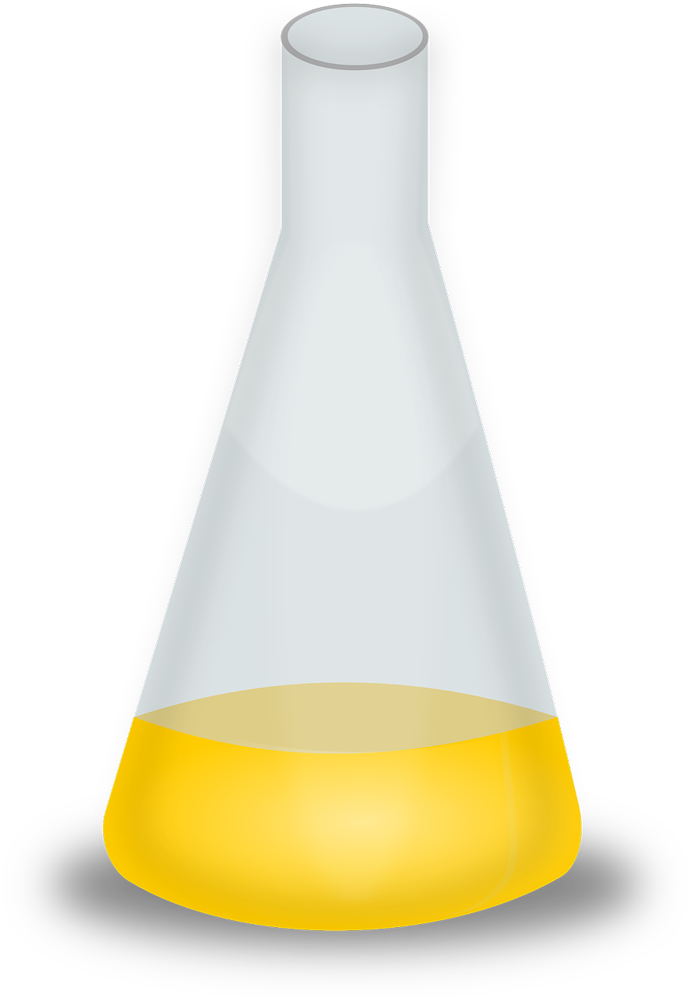

Which flask contains the most concentrated solution?
= solute particle
= solvent particle
Notes:
Answer: A
Note: Each magnifying glass is observing the same volume of liquid.
Image source: Pixabay

Slide 14
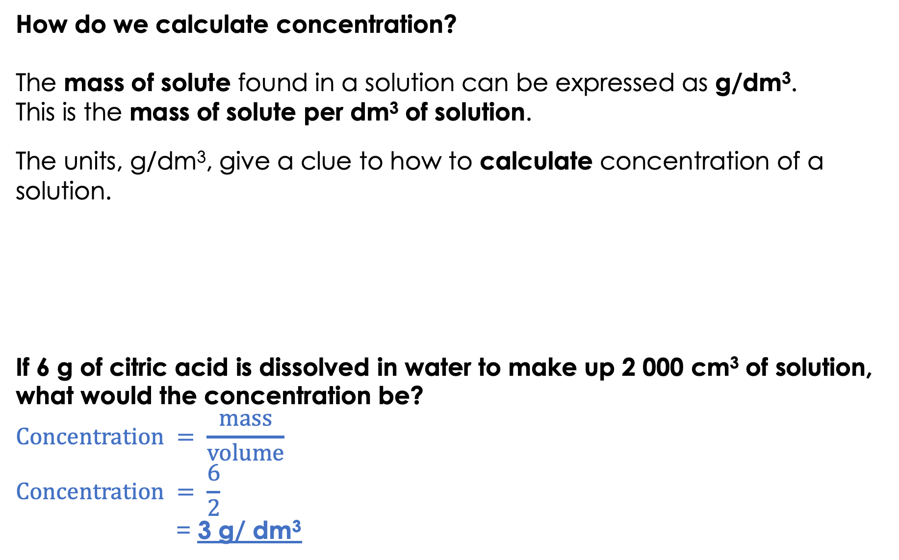
How do we calculate concentration?
The mass of solute found in a solution can be expressed as g/dm³.
This is the mass of solute per dm³ of solution.
The units, g/dm³, give a clue to how to calculate concentration of a solution.
If 6 g of citric acid is dissolved in water to make up 2 000 cm³ of solution, what would the concentration be?
$$Concentration = \frac{mass}{volume}$$
$$Concentration = \frac{6}{2}$$
= 3 g/ dm³
÷
The volume needs to be in dm³.
cm³ ÷ 1000 = dm³
Mass
volume
g/dm³
2 000cm³ ÷ 1 000 = 2 dm³
Notes:
Purpose: to introduce new learning.
It is helpful to be able to demonstrate this for students in a practical way as you talk through the slide. Have a solution (say of salt and water) in front of you, to show the solute mass and volume of the solution as an example.
This activity introduces concentration in a quantitative way.
Note: It is incorrect to say: mass of solute dissolved in 1 dm³ of solvent. This is because the volume will increase when the solute is added/ dissolves.

Slide 15
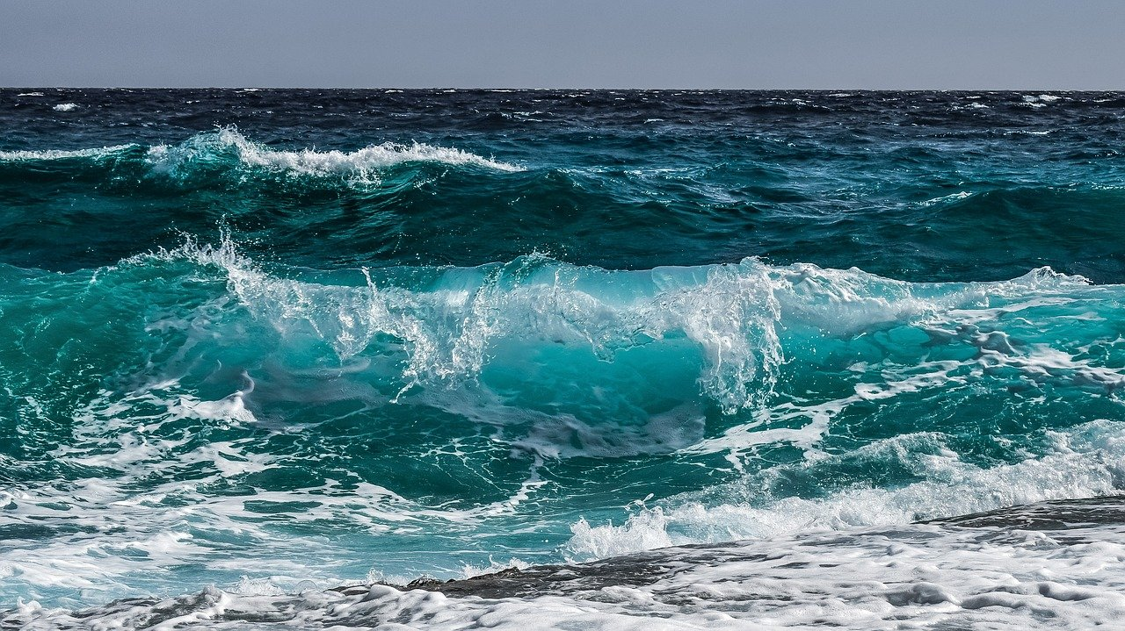
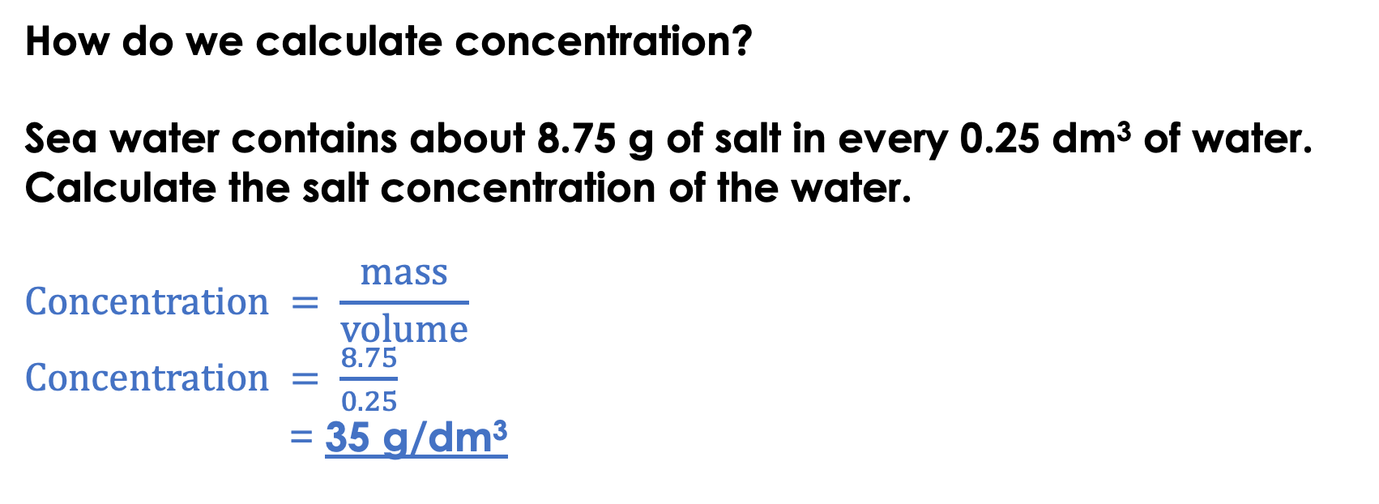
How do we calculate concentration?
Sea water contains about 8.75 g of salt in every 0.25 dm³ of water.
Calculate the salt concentration of the water.
$$Concentration = \frac{mass}{volume}$$
$Concentration = \frac{8.75}{0.25}$
= 35 g/dm³
The volume needs to be in dm³.
✓
Notes:
Purpose: to introduce new learning.
This activity introduces concentration in a quantitative way. Note: only HT Chemistry needs to know mol/ dm³
Note: This topic is closely linked to titrations – which are a later part of this unit. The AQA specification statement: ‘If the volumes of the two solutions that react completely are known and the concentration of one solution is known, the concentration of the other solution can be calculated’ is covered later in this unit.
Image from pixabay

Slide 16
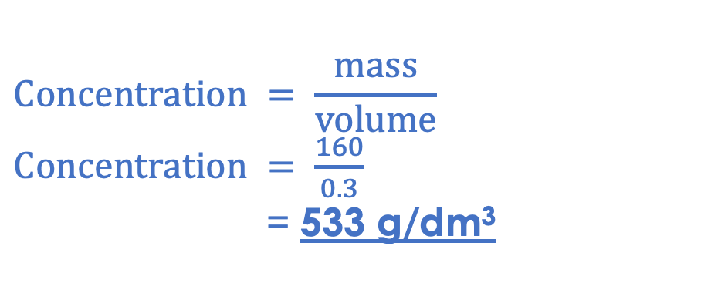
160 g of sodium hydroxide is used to make 300 cm³ of solution. What is the concentration?
Steps:
What is the question asking?
What information does the question give you?
Write down the correct equation.
Substitute the numbers.
Rearrange the equation if necessary.
Complete the calculation.
Add units.
160 g is the mass of solute
300 cm³ is the volume of the solution
=0.3 dm³
$$Concentration = \frac{mass}{volume}$$
$Concentration = \frac{160}{0.3}$
= 533 g/dm³

Slide 17
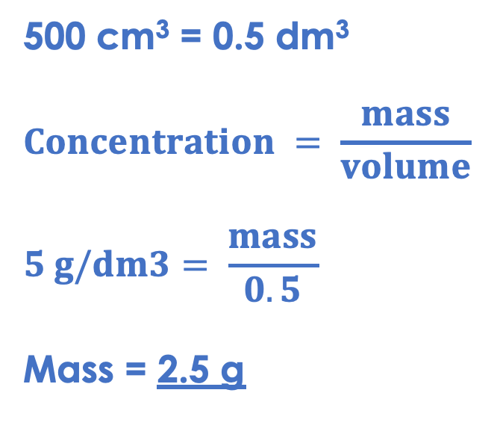
Discuss with your partner how you should solve this question. Work together to find the answer. Some glucose was dissolved in 500 cm³ of water. The concentration of the solution was 5 g/dm³. What mass of glucose was dissolved in the solution?
500 cm³ = 0.5 dm³
$$Concentration = \frac{mass}{volume}$$
$$5 g/dm3= \frac{mass}{0.5}$$
Mass = 2.5 g
Notes:
Suggested guidance:
Talk tasks can be used in a variety of ways to suit the particular needs of the students you are teaching. Through exchanging views with others, students develop their understanding of the science beyond what could be achieved individually.
Science classrooms that successfully integrate talk have the following features:
Science talk is a regular feature of lessons and is woven into classroom activities.
Students are paired or grouped strategically by the teacher to ensure productive interaction. This might take into consideration the students’ proficiency of the English language, how encouraging they might be to peers and their attainment in the topic. It’s a good idea to consider these pairings in the class seating plan.
Students are encouraged and supported to talk, but are not forced to talk.
The teacher should take on the role of a facilitator, engaging with conversations where necessary and encouraging or steering the conversation where needed.
Students are encouraged to use the language they have to express their ideas (e.g., everyday language, imperfect English, native language), but also to incorporate science specific terminology where this is more accurate or has been taught.
6. Scientifically inaccurate ideas are not dismissed by the partner or teacher; open discussion and further investigation are relied on to help students construct ideas that support them to progress in their scientific understanding.
7. Guidelines for behaviour during talk tasks are explicit and frequently reviewed. Rules for students might be:
Listen carefully to your partner
Take turns talking.
Speak one at a time, without interrupting.
Politely agree or disagree and explain why.
Politely point out if your partner has used a scientific word incorrectly, if they have explained the science incorrectly, or if there is a more accurate way to describe something.
If confused, ask questions.
Stay focused on the discussion topic.
Respond to one another.

Slide 18


True or false?
To convert cm³ into dm³ you need to multiply by 1000.
250 cm³ = 0.25 dm³
250 cm³ of a 4 g/dm³ solution contains 1 g of solute.
0.5 dm³ = 5000 cm³
5.5 g of copper sulfate is dissolved in 500 cm³ to form a 11 g/dm³ solution.
False
True
True
False
True
Notes:
Purpose: to check that key knowledge from the introduce phase has been learnt and understood.
You may wish to provide students with white boards to enable them to carry out calculations.
1F; 2T; 3T; 4F; 5T;

Slide 19
Drill
Define concentration.
State the equation that links concentration, mass and volume.
State the unit for mass.
State the unit for volume
State the unit for concentration.
Convert 5000 cm³ into dm³.
Define solute.
Define solvent.
Define solution.
Notes:
Purpose: This is a knowledge drill. The purpose of this is to check that the critical knowledge is secure before pupils move onto independent practice.
Suggested guidance: There are a range of ways this could be done depending on time and ability range of the class:
Mini whiteboards
As full sentences in exercise books
As short answers in exercise books
In the pupil workbook
As pair talk
As cold call

Slide 20
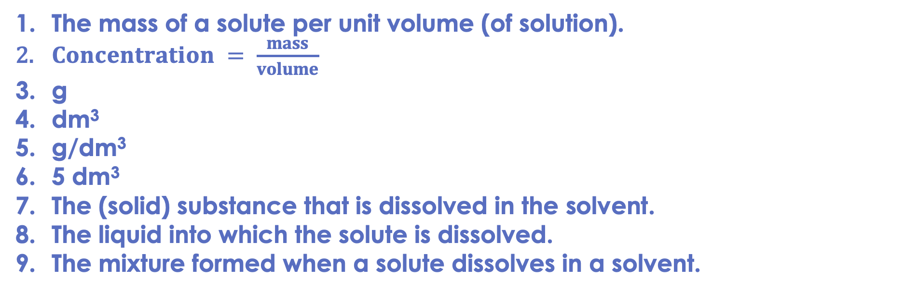
Drill answers
The mass of a solute per unit volume (of solution).
$Concentration = \frac{mass}{volume}$
g
dm³
g/dm³
5 dm³
The (solid) substance that is dissolved in the solvent.
The liquid into which the solute is dissolved.
The mixture formed when a solute dissolves in a solvent.
Notes:
Purpose: This is a knowledge drill. The purpose of this is to check that the critical knowledge is secure before pupils move onto independent practice.
Suggested guidance: There are a range of ways this could be done depending on time and ability range of the class:
Mini whiteboards
As full sentences in exercise books
As short answers in exercise books
In the pupil workbook
As pair talk
As cold call

Slide 21
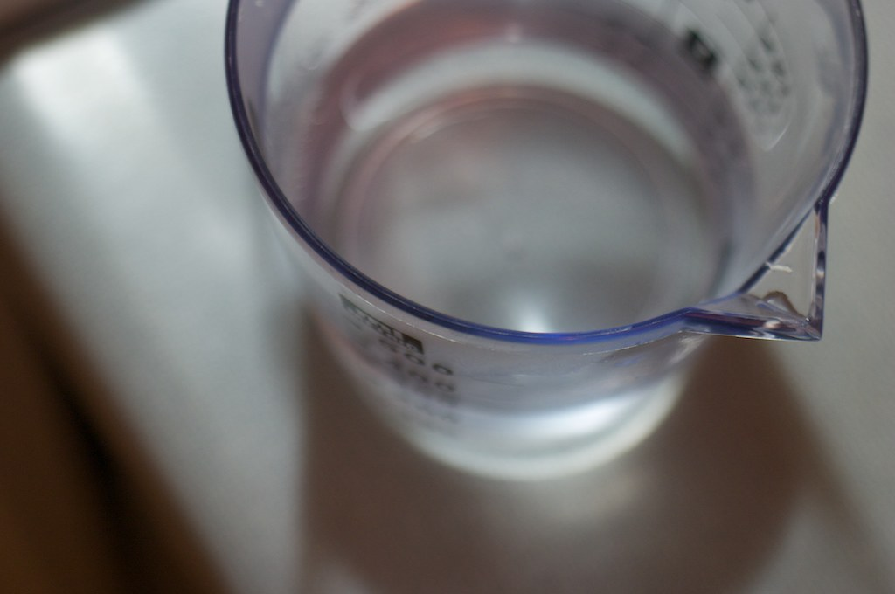



I: Calculating concentration
A scientist makes a solution of salt water. They dissolve 750 g of salt to make up a solution of 1000 cm³.
1 000 cm³ ÷ 1 000 = 1 dm³
What is the solute?
salt
What is the solvent?
water
What is the solution?
salt water
What is the concentration of the solution?
$concentration$= $\frac{mass}{volume}$
$concentration$= $\frac{75}{1}$
$concentration$= 75$g/dm3$
Notes:
Purpose: The I-We-You section aims to support pupils to build skills that they most commonly need when answering questions associated with this knowledge in the assessment. This section is also used to interleave other content we expect pupils to know at this stage of their education in order that they build a big picture of the science they are learning.
For the ‘I’ activity, the teacher should model how to answer the question. They can do this by narrating their thinking process aloud, and making links to learning earlier in the lesson explicit.
For the ‘we’ activity, the teacher and students work though a similar example together, in order to prepare students to be able to answer a similar question independently.
Opportunities for the ‘you’ activity – independent practise – occur in the activity portion of the lesson once the student is secure enough to process independently.

Slide 22
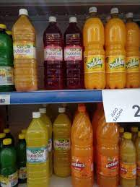



We: Concentration, mass and volume
A manufacturer makes a solution of squash by dissolving 114 g of squash to make 2 dm³ of solution.
What is the concentration of the squash?
$concentration$= $\frac{mass}{volume}$
$concentration$= $\frac{114 g}{2 {dm}^{3} }$
$$concentration=57g/dm3$$
Notes:
Purpose: The I-We-You section aims to support pupils to build skills that they most commonly need when answering questions associated with this knowledge in the assessment. This section is also used to interleave other content we expect pupils to know at this stage of their education in order that they build a big picture of the science they are learning.
For the ‘I’ activity, the teacher should model how to answer the question. They can do this by narrating their thinking process aloud, and making links to learning earlier in the lesson explicit.
For the ‘we’ activity, the teacher and students work though a similar example together, in order to prepare students to be able to answer a similar question independently.
Opportunities for the ‘you’ activity – independent practise – occur in the activity portion of the lesson once the student is secure enough to process independently.

Slide 23
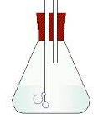

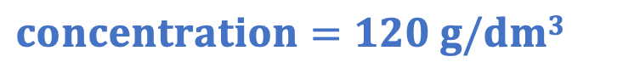

You: Concentration, mass and volume
A scientist makes up a sample of calcium hydroxide solution. 24 g of calcium hydroxide is added to water to make up 200 cm³ of solution.
What is the solute?
calcium hydroxide
What is the solution?
calcium hydroxide solution
What is the concentration of the sample?
What is the volume in dm³?
$concentration$= $\frac{mass}{volume}$
$$200 cm3=0.2 dm3$$
$concentration$= $\frac{24}{0.2}$
$$concentration=120 g/dm3$$
Notes:
Purpose: The I-We-You section aims to support pupils to build skills that they most commonly need when answering questions associated with this knowledge in the assessment. This section is also used to interleave other content we expect pupils to know at this stage of their education in order that they build a big picture of the science they are learning.
For the ‘I’ activity, the teacher should model how to answer the question. They can do this by narrating their thinking process aloud, and making links to learning earlier in the lesson explicit.
For the ‘we’ activity, the teacher and students work though a similar example together, in order to prepare students to be able to answer a similar question independently.
Opportunities for the ‘you’ activity – independent practise – occur in the activity portion of the lesson once the student is secure enough to process independently.

Slide 24
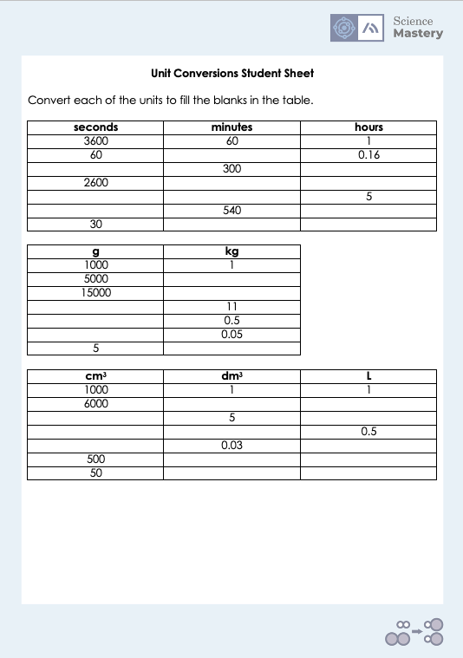
Activity: Unit conversions

Slide 25
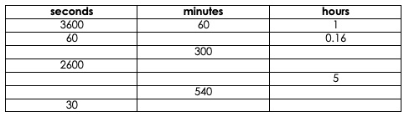
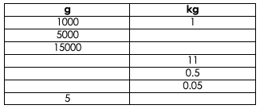
Answers
1
18 000
5
43.33
0.72
18 000
300
32 400
9
0.5
0.0083
1
15
11 000
500
50

Slide 26
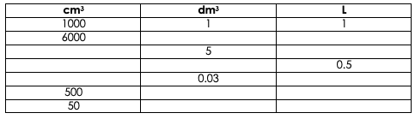
Answers
6
6
5 000
5
500
0.5
30
0.03
0.5
0.5
0.05
0.05

Slide 27
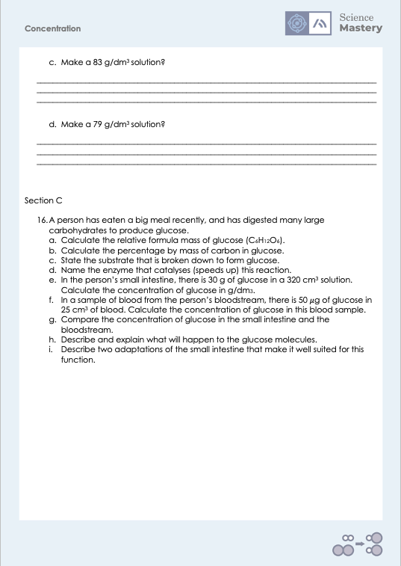
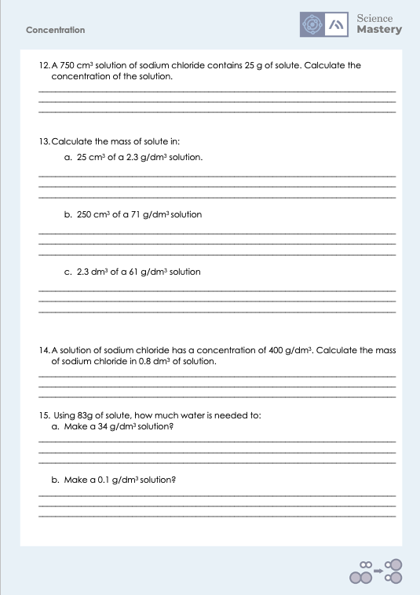
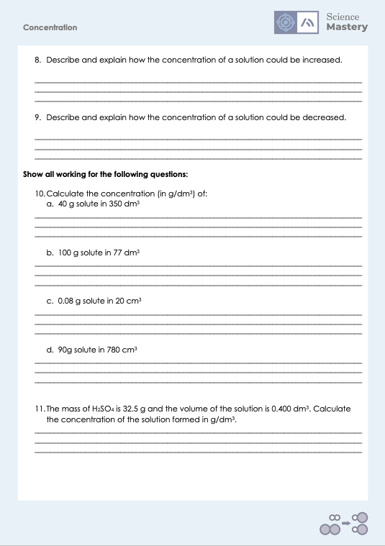
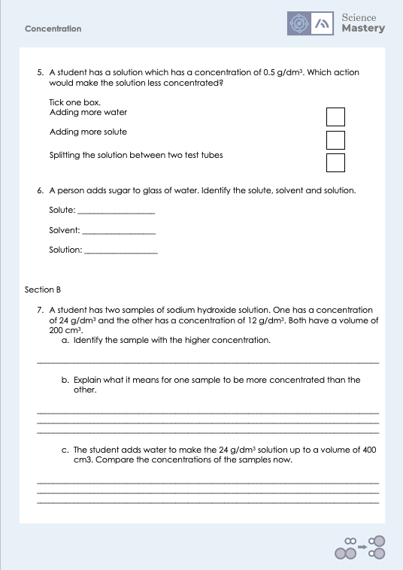
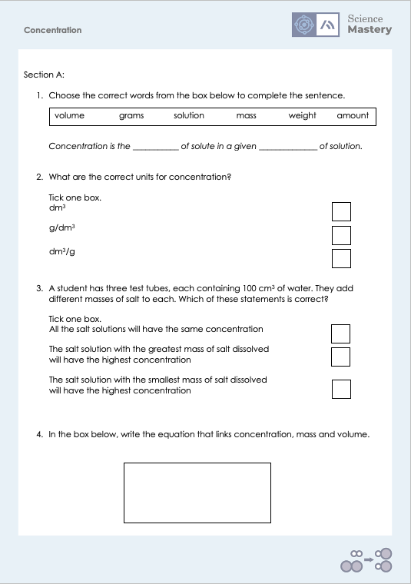
Activity

Slide 28
Answers
1. Concentration is the mass of solute in a given volume of solution.
2. g/dm³
3. The salt solution with the greatest mass of salt dissolved will have the highest concentration.
4. $Concentration=\frac{mass}{volume}$
5. Adding more water
6.
Solute: sugar
Solvent: water
Solution: sugary water

Slide 29
Answers
7a. 24 g/dm³
7b. The sample with the higher concentration has a greater mass of solute (sodium hydroxide) dissolved in the same volume of solution.
7c. They will now have the same concentration, as the mass of solute has not changed but the volume of solution has doubled.
8. Adding more solute, so there is a greater mass per unit volume of solution (or reducing the volume of solvent in solution by evaporation).
9. Adding more solvent to the solution so there is a smaller mass of solute per unit volume (or reducing the mass of solute).

Slide 30
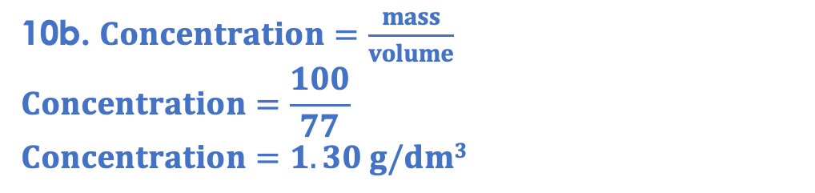
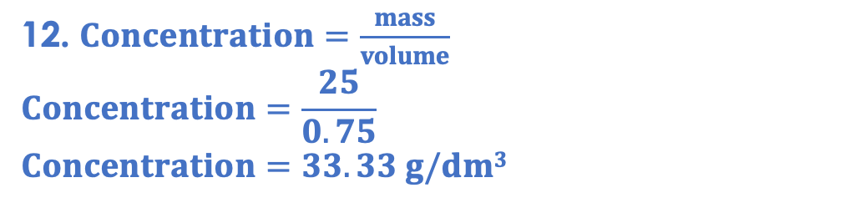
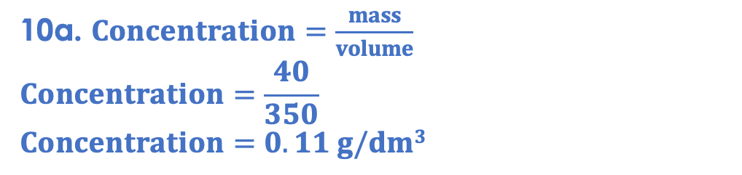
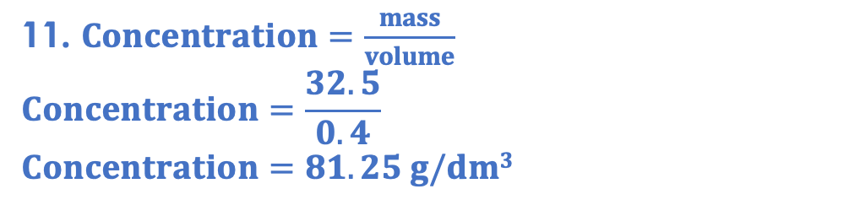
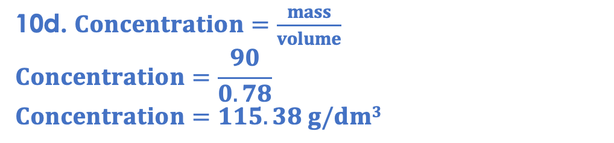
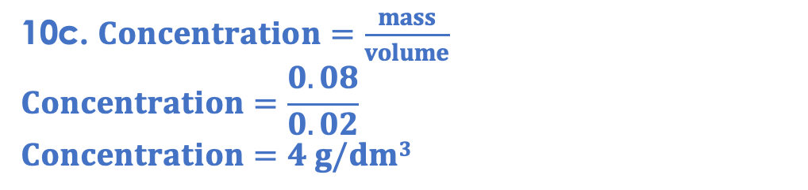
Answers
10a. $Concentration=\frac{mass}{volume}$
$$Concentration=\frac{40}{350}$$
$$Concentration=0.11 g/dm3$$
10d. $Concentration=\frac{mass}{volume}$
$$Concentration=\frac{90}{0.78}$$
$$Concentration=115.38 g/dm3$$
10b. $Concentration=\frac{mass}{volume}$
$$Concentration=\frac{100}{77}$$
$$Concentration=1.30 g/dm3$$
11. $Concentration=\frac{mass}{volume}$
$$Concentration=\frac{32.5}{0.4}$$
$$Concentration=81.25 g/dm3$$
10c. $Concentration=\frac{mass}{volume}$
$$Concentration=\frac{0.08}{0.02}$$
$$Concentration=4 g/dm3$$
12. $Concentration=\frac{mass}{volume}$
$$Concentration=\frac{25}{0.75}$$
$$Concentration=33.33 g/dm3$$

Slide 31
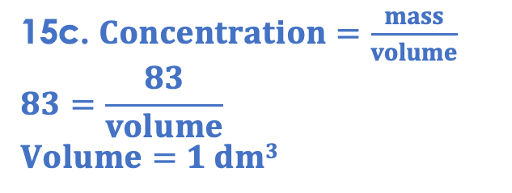
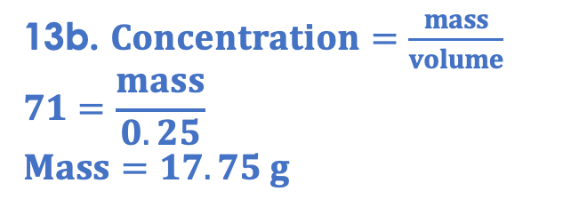
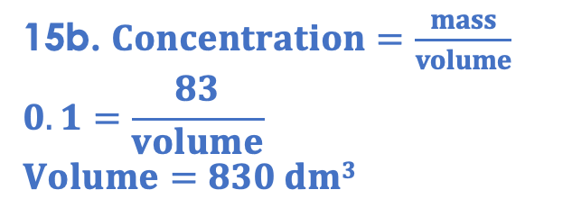
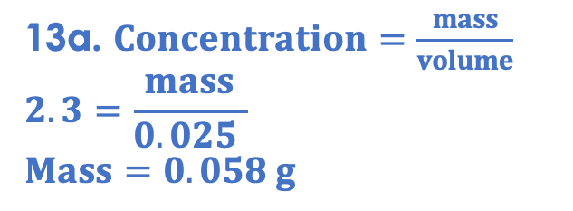
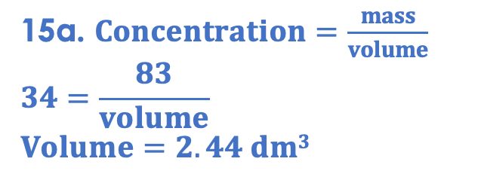
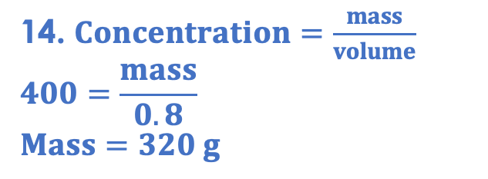
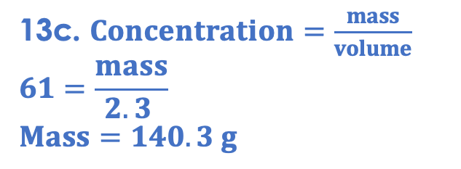
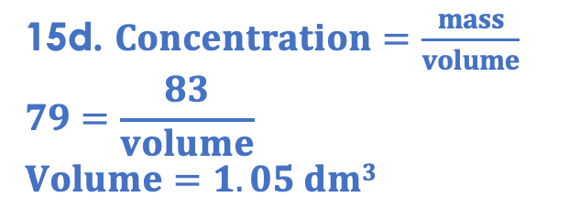
Answers
15a. $Concentration=\frac{mass}{volume}$
$$34=\frac{83}{volume}$$
$$Volume=2.44 dm3$$
13a. $Concentration=\frac{mass}{volume}$
$$2.3=\frac{mass}{0.025 }$$
$$Mass=0.058 g$$
15b. $Concentration=\frac{mass}{volume}$
$$0.1=\frac{83}{volume}$$
$$Volume=830 dm3$$
13b. $Concentration=\frac{mass}{volume}$
$$71=\frac{mass}{0.25}$$
$$Mass=17.75 g$$
15c. $Concentration=\frac{mass}{volume}$
$$83=\frac{83}{volume}$$
$$Volume=1 dm3$$
13c. $Concentration=\frac{mass}{volume}$
$$61=\frac{mass}{2.3 }$$
$$Mass=140.3 g$$
15d. $Concentration=\frac{mass}{volume}$
$$79=\frac{83}{volume}$$
$$Volume=1.05 dm3$$
14. $Concentration=\frac{mass}{volume}$
$$400=\frac{mass}{0.8}$$
$$Mass=320 g$$

Slide 32
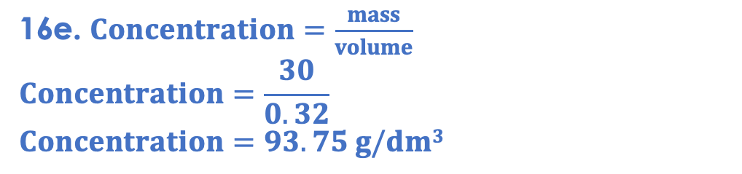
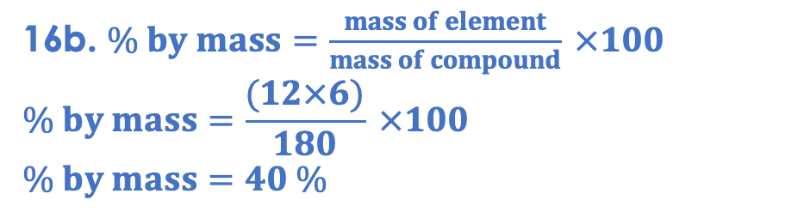
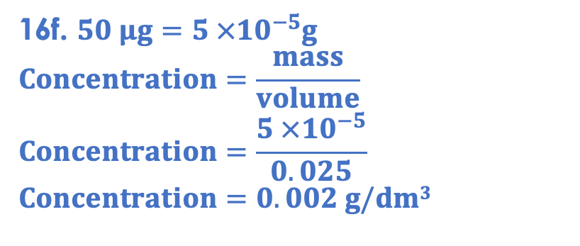
Answers
16f. $50 μg=5 ×{10}^{−5}g$
$$Concentration=\frac{mass}{volume}$$
$$Concentration=\frac{5 ×{10}^{−5}}{0.025}$$
$$Concentration=0.002 g/dm3$$
16a. (12x6)+(1x12)+(16x6) = 180
16b. $\% by mass=\frac{mass of element}{mass of compound} ×100$
$$\% by mass=\frac{(12×6)}{180} ×100$$
$$\% by mass=40 \%$$
16g. The concentration of glucose in the small intestine is (46 875 times) higher than the concentration of glucose in the blood.
16c. Starch
16d. Amylase (carbohydrase)
16h. Glucose molecules will diffuse from the small intestine to the bloodstream, from an area of high concentration to an area of low concentration.
16e. $Concentration=\frac{mass}{volume}$
$$Concentration=\frac{30}{0.32}$$
$$Concentration=93.75 g/dm3$$
16h.
Villi to increase surface area
Microvilli to increase surface area
Good blood supply to maintain concentration gradient

Slide 33
Answer the questions below.
Select the answer below which is equal to 0.05 dm³.
A. 500 cm³
B. 50 cm³
C. 0.00005 cm³
✓
10 g of a solute was used to make a solution with a volume of 25 dm³. What was the concentration of the solution?
A. 250 g/dm³
B. 0.4 g/dm³
C. 2.5 g/dm³
✓
200 cm³ of a solution has a concentration of 25 g/cm3. What mass of solute was dissolved in it?
A. 5000 g
B. 125 g
C. 5 g
✓
Notes:
Q1. Answer: B
If students answer A, it suggests they have multiplied by 10000 instead of 1000. To fix-it, give the student some more unit conversions to practise. Use slide 7 to reteach the method for converting from one unit to another.
If students answer C, it suggests they have divided by 1000 instead of multiplying by 1000 to convert dm³ to cm³. To fix it, reteach how to convert from one unit to another, using slide 7 to help. Give students some unit conversions to practice.
Q2. Answer: B
If students answer A, it suggests that they have multiplied the mass and volume instead of dividing. If students answer C, it suggests that they have divided volume by mass instead of the other way around. To fix it, remind the student of the correct formula to calculate concentration. Model the method to work this calculation out, and then give the student some similar calculations to try.
Q3. Answer: B
If students answer A, they have done the correct calculation but not converted the volume to dm³. If students answer B, they have converted the volume to dm³ but divided concentration by volume. To fix it, give students more calculation practice with conversions.

Slide 34
Lesson C4.3.4
What was good about this lesson? | What can we do to improve this lesson?
Send us your feedback by clicking this link
or by emailing sciencemastery@arkonline.org
Thank you!

